Slide 1
Machine Learning
Kapil Dev Pant (6 hrs)

Slide 2
Contents
Definition and Evolution of Machine Learning
Learning by Analogy
Explanation-based learning
Supervised Learning Algorithms
Classification and Regression
Linear regression
K-Nearest Neighbor
Unsupervised Learning Algorithms
Clustering
K-means Clustering
Artificial Neural Network
Biological Inspiration
Basic Components of ANN
Training Neural Networks
Forward Propagation
Loss Function
Backward Propagation
Learning Rate
Single-Layer Perceptron
Multi-Layer Perceptron

Slide 3
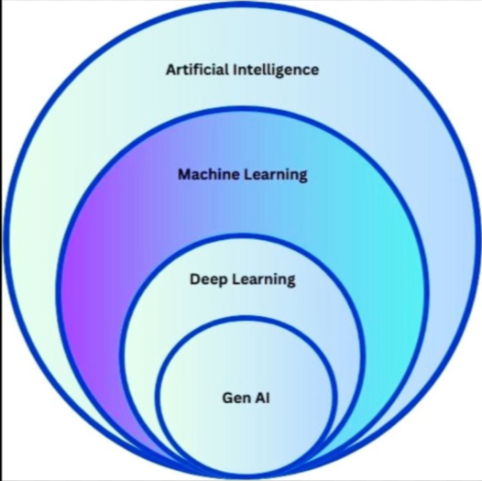
Machine Learning
Field of Artificial Intelligence (AI) that enables systems to learn and improve from experience without being explicitly programmed.
Focus on developing algorithms that can process data, identify patterns, and make decisions.
Key characteristics
Data Driven Approach
Adaptive and Scalable
Predictive Modeling
Notes:
Data-driven Approach:
Machine learning relies heavily on data. It learns patterns, relationships, and trends from historical data to make predictions or decisions without requiring explicit programming for each task.
The more data it has, the better the model can learn and perform.
Adaptive and Scalable:
Machine learning models can adapt to new data over time, improving their accuracy and efficiency without manual intervention.
Scalability refers to their ability to handle increasing amounts of data or complexity, making them suitable for real-world applications.
Predictive Modeling:
One of the core strengths of machine learning is its ability to predict future outcomes based on learned patterns.
It is widely used in forecasting, such as predicting stock prices, customer behavior, or disease outbreaks.

Slide 4
Evolution of Machine Learning
Era | Focus | Impact
1950s–70s | Early neural & symbolic AI | Laid foundations
1980s–90s | Statistical ML & algorithms | Broader applicability
2000s | Deep learning starts | Breakthrough performance
2010s | Scalable architectures | Image, speech, vision
2017+ | Transformers & NLP | Language & large models
2020s | Generative/Foundational AI | Creativity & reasoning
2025–2026 | Integrated agents & physical AI | Smart systems interacting with world
Notes:
1. Early Foundations (1940s–1950s)
Biological Inspiration & First Ideas
In 1943, Warren McCulloch and Walter Pitts created the first mathematical model of a neuron, proposing a network of artificial neurons.
In 1949, Donald Hebb published a theory on learning in the brain, later influencing how artificial neural networks adjust weights.
2. Birth of Machine Learning (1950s–1960s)
Early ML Concepts and Algorithms
1950: Alan Turing proposed the idea of “thinking machines” and the Turing Test.
1956: Term “Artificial Intelligence” was coined at the Dartmouth Conference, marking AI as a field.
1957: Perceptron : first practical artificial neuron model by Frank Rosenblatt is introduced.
These early ML models could learn from data, but were limited in power and scope.
3. Classical Machine Learning (1970s–1990s)
Statistics + Algorithms Become Core
ML expands beyond neural nets to statistical models and rule-based learning.
Common models developed or popularized:
Nearest Neighbors (k-NN)
Decision Trees
Support Vector Machines (SVMs) (1990s)
Boosting and ensemble methods like AdaBoost and Random Forests.
Backpropagation Revival (1986)
Rumelhart, Hinton & Williams rediscover backpropagation, enabling neural networks to learn multi-layer models
4. Deep Learning Revolution (2000s–2010s)
Data + Compute + GPUs
The availability of big data and powerful parallel GPUs transforms ML dramatically.
2006: Deep belief networks show deep models can be effectively trained.
2012: AlexNet wins ImageNet, a huge AI milestone, proving deep learning vastly outperforms traditional ML in image recognition
5. Modern ML: NLP & Transformers (2017+)
Transformers Architecture
In 2017, the Transformer model introduces self-attention, enabling much more powerful language understanding.
This approach fuels BERT, GPT, and other pretrained foundation models that excel at language tasks.
Example modern breakthroughs:
GPT-3 (2020): Large language model with 175B parameters
ChatGPT (2022): Popularized generative conversational AI
GPT-4+: Multimodal models handling text + images + more
6. Reinforcement & Interactive AI
Reinforcement Learning (RL) Gains Prominence
Though developed earlier, RL becomes central with successes like AlphaGo’s Go victory (2016) and robotics learning through experimentation.
RL ideas also power adaptive systems in robotics, gaming, finance, and autonomous control
7. Large-Scale & Generative AI Era (2020s–2026)
Era of Foundation Models & Generative AI
ML shifts from narrow models to large pretrained systems capable of generation (texts, images, code, music).
Generative AI now drives automation, creativity tools, assistants, agents, and personalized services across industries.
Emerging Trends (2025–2026)
New approaches like energy-based reasoning models are being pursued to improve reasoning and reduce hallucinations.
Integration of ML with physical systems (robots that adapt and learn in dynamic environments) is accelerating.
The lines between traditional supervised ML and generative methods are blurring as automation and synthetic data reshape workflows.
The research community continues to explore more efficient models, hardware accelerators, and democratization of ML tools
symbolic artificial intelligence (also known as classical artificial intelligence or logic-based artificial intelligence) is the term for the collection of all methods in artificial intelligence research that are based on high-level symbolic (human-readable) representations of problems, logic and search
Symbolic AI used tools such as logic programming, production rules, semantic nets and frames and it developed applications such as knowledge-based systems (in particular, expert systems), symbolic mathematics, automated theorem provers, ontologies, the semantic web, and automated planning and scheduling systems.
The Symbolic AI paradigm led to seminal ideas in search, symbolic programming languages, agents, multi-agent systems, the semantic web, and the strengths and limitations of formal knowledge and reasoning systems

Slide 5
Machine Learning
What is learning and why needed?
Why we want agent to learn? | we just improve the problem that is there in model?
Designer can't anticipate all possible situation, that agent might come across. e.g.: maze
Designer can't anticipate all changes over time. Eg : stock market
Human programmer don’t have idea to solve problem by themselves. Eg: face detection
Notes:
Machine Learning is needed because traditional programming fails when rules are too complex, data is huge, or systems must learn and adapt automatically.
Limitations of Traditional Programming
Traditional Programming: Rules + Data → Output
Problems:
Rules must be explicitly written
Not scalable for complex problems
Cannot adapt or improve automatically
But What ML does ? ::::Data + Output → Rules (Model)
Thus-.
Learns patterns automatically Improves with more data
Example: Spam detection
Traditional: Write thousands of rules
ML: Learn spam patterns from emails
2. Explosion of Data (Big Data Era)
Today we generate:
Social media data
Sensor data
Images, videos, audio
Transaction records
Humans cannot analyze this manually but ML finds hidden patterns in massive data
Example: Netflix recommendations
Google search ranking
Credit card fraud detection
3. Problems Where Rules Are Unknown or Impossible
Some problems cannot be defined using fixed rules.
Examples:
Speech recognition
Face recognition
Language translation
Handwriting recognition
ML learns directly from examples instead of rules
4. Systems That Must Learn & Adapt
ML systems can improve over time.
Examples:
Self-driving cars learning road behavior
Recommendation systems adapting to user taste
Stock prediction models updating with new data
5. Automation & Efficiency
ML enables:
Faster decision-making
Reduced human effort
24/7 operation
Examples:
Chatbots
Automated medical diagnosis
Smart assistants
6. Better Accuracy & Predictions
ML models often outperform humans and rule-based systems when:
Data is large
Patterns are complex
Examples:
Disease prediction
Weather forecasting
Demand forecasting
7. Foundation of Modern AI
Machine Learning powers:
Artificial Intelligence
Deep Learning
Generative AI
Robotics
Without ML: AI would remain static and rule-based

Slide 6
Learning by Analogy
Learning by drawing parallels between a new situation and previously encountered situations.
Solving a problem in one domain by applying the solution from a different domain.
Involves abstracting details from a particular set of problems and resolving structural similarities between previously distinct problems
Applications:
Case-based reasoning systems
Natural language processing (e.g., metaphor understanding)
Advantages:
Intuitive and efficient for human-like learning.
Notes:
Definition:
Learning by analogy involves solving new problems or understanding new situations by drawing parallels with previously encountered problems or situations. It is a process of mapping knowledge from one domain to another.
Example:
Imagine solving a complex engineering problem by applying a solution learned in biology, such as using the structure of a honeycomb to design lightweight, strong building materials. This demonstrates how knowledge from one context is adapted to another.
Applications:
Case-Based Reasoning Systems:
Systems store past cases and use analogies to solve new problems by finding and adapting solutions from similar previous cases.
Natural Language Processing (NLP):
Understanding metaphors and analogies in language, such as interpreting expressions like “time is money,” involves analogy-based reasoning.
Advantages:
Intuitive: Mimics human reasoning, making it a natural and relatable learning method.
Efficient: Reduces the need for exhaustive computation by leveraging existing knowledge.
Examples:
Biomimicry in Engineering:
Engineers design bullet trains inspired by the beak of the kingfisher bird, which reduces noise and drag when diving into water. The analogy from nature helps improve efficiency in transportation.
Education and Teaching:
Teachers often use analogies to explain complex concepts. For example:
Teaching electricity flow by comparing it to water flowing through pipes.
Explaining the structure of an atom by comparing it to a solar system (electrons orbiting the nucleus like planets around the sun).
Medical Diagnosis:
Doctors use analogy-based reasoning to diagnose diseases. For instance, if a patient’s symptoms resemble a known case of a specific illness, they use the knowledge of the prior case to suggest treatments.
Software Development:
A programmer may solve a new software bug by recalling a similar issue they resolved in another project and adapting the solution.
Marketing and Advertising:
Analogies are often used in branding and messaging. For example, Apple used the analogy of “bicycles for the mind” to describe computers, emphasizing their ability to amplify human capabilities.
Robotics:
Robots learn to perform tasks by observing human behavior. For example, a robot may learn to grasp objects by observing how humans manipulate objects using their hands.
Design Thinking:
Designers use analogy to create innovative solutions. For example, designing a user interface for a complex software program by using the metaphor of a physical workspace (e.g., desktop icons representing documents or tools).
Why Analogical Learning is Powerful:
It bridges gaps between unfamiliar and familiar concepts.
It facilitates problem-solving in fields where direct solutions are unavailable by using insights from unrelated domains.

Slide 7
Analogical Reasoning Steps
Retrieve:- Retrieve cases from memory that are relevant to solving it.
Reuse:- Map the solution from previous case to the target problem. This involves adapting the solution to fit new solution.
Revise:- Test the new solution to real world and, if necessary, revise.
Retain: After solution is successfully adapted in target problem, store resulting experience as a new case inn memory.

Slide 8
Explanation-Based Learning (EBL)
A learning technique where a system generalizes from a single example by understanding the underlying explanation.
Steps in EBL:
1. Analyze a specific example.
2. Extract the generalized rule or explanation.
3. Apply the rule to similar problems.
Applications:
Knowledge-based systems.
Robotics and automated planning.
Observation
Explanation
Generalization
Learning
Notes:
Explanation-Based Learning (EBL) is a form of machine learning where the system learns from examples by constructing a general explanation of the problem domain. Unlike traditional learning techniques, which typically rely on a large number of labeled training examples, EBL focuses on using a single or a few examples, along with background knowledge, to form a general rule that can be applied to other similar situations.
Here’s how EBL generally works:
Observation: The system observes a specific instance or a few examples of the task at hand. These are typically situations where the system has already observed or completed some form of reasoning or decision-making.
Explanation: The system then uses its background knowledge to generate an explanation of why the observed instance is a valid example. This could involve applying existing domain rules or reasoning processes to the example to understand why the outcome occurred.
Generalization: From the explanation, the system abstracts a more general rule or principle that applies not just to the example, but to a broader set of similar situations. This step may involve simplifying or removing irrelevant details, focusing only on the core features that lead to the outcome.
Learning: The system incorporates this general rule into its knowledge base, effectively "learning" from the instance. The learned rule can then be used to solve new, unseen instances that share similar characteristics.
Advantages of EBL:
Efficiency: Since it requires fewer examples, EBL can be more efficient in scenarios where examples are hard to obtain or expensive.
Leverage of background knowledge: EBL makes explicit use of domain knowledge, which can improve learning in complex tasks where raw data alone may not be sufficient.
Example:
Consider a scenario where a robot needs to learn how to stack objects. If it observes one successful attempt at stacking, it can generate an explanation based on its knowledge (such as stability rules for stacking), and then generalize that rule to other stacking situations. Instead of needing hundreds of examples, it learns the principle from a single successful experience.
EBL is often seen as a way to improve learning efficiency, especially in cases where deep, domain-specific understanding is required to make sense of individual examples.

Slide 9
Feedback Based Learning
Types of Learning
Supervised Learning
Unsupervised Learning
Reinforced Learning

Slide 10
Supervised Learning
Learning from labeled data, where the algorithm maps inputs to known outputs.
The goal is to learn the mapping from inputs to outputs such that it predict the output for new, unseen inputs.
Key Characteristics:
Requires a labeled dataset.
Goal: Minimize the error between predictions and actual outputs.
Learning Process:
Data Collection (input-output pairs)
Data Preprocessing (cleaning, normalization)
Model Selection (choose a learning algorithm)
Training the Model
Model Evaluation (accuracy, precision, etc.)
Prediction
Notes:
Definition:
Supervised learning is a type of machine learning where the algorithm is trained on a labeled dataset. This means that for each input data point, the corresponding correct output (label) is also provided. The goal is for the model to learn the mapping from inputs to outputs so that it can predict the output for new, unseen inputs.
It is called “supervised” because the learning process is guided by the ground truth labels, like a teacher supervising the learning process.
🔹 Example:
Imagine a dataset of student exam scores and their final grades (A, B, C...). Here, the input features might be:
Hours studied
Attendance
Assignment scores
The label/output is:
Final grade
The model learns how these inputs relate to the output so it can predict a student’s grade based on similar features.
🔹 How it Works:
You provide the algorithm with a training dataset that includes both the input (features) and the correct output (label).
The algorithm processes the data and adjusts its internal parameters to minimize the difference between the predicted output and the actual output.
After training, the model is tested on new data to check how accurately it can generalize the pattern it has learned.
🔹 Core Idea:
It’s essentially a function approximation problem — the model tries to find a function f(x) such that:
f(input) ≈ output
🔹 Categories of Supervised Learning:
Classification – When the output is a category (e.g., Spam/Not Spam)
Regression – When the output is a continuous value (e.g., price, temperature)
🔹 Importance:
Supervised learning is widely used in practical applications because real-world problems often come with labeled data.
It allows us to make informed decisions and predictions based on historical data.

Slide 11
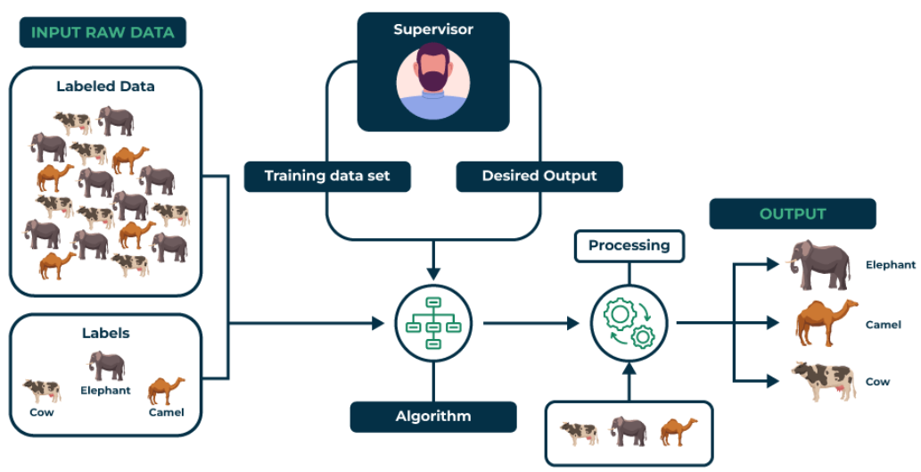
Supervised Learning
Notes:
Advantages of Supervised Learning
1. This type of learning is easy to understand. It is the most common type of learning method. For, learning ML, people should start by practicing supervised learning.
2. The training data is only necessary for training the model. Since it is large it occupies a lot of space. But, it’s removed from the memory as it is of no importance after training is complete.
3. We would already know the number of classes in the data.
4. After training, the model would for which specific data the output needs to be predicted as all the data in the collection is not important.
5. It is very helpful in solving real-world computational problems.
6. This learning method can also help the model to learn from previous experiences and to improve its accuracy in prediction.
Disadvantages of Supervised Machine Learning
1. It’s performances are limited to the fact that it can’t handle complex problems in ML.
2. It cannot create labels of its own. This means that, it cannot discover data on its own like unsupervised learning.
3. If we enter new data, it has to be from any of the given classes only. If you enter watermelon data in a collection of apples and oranges, it might classify the watermelon into one of these classes, which won’t be right.
4. It would require a good computer with quality processors to train a supervised learning-based model. It requires high computation power, which not all PC’s might have.

Slide 12
Two approaches of Supervised Learning
Classification: A classification problem is when the output variable is a category, such as “Red” or “blue” , “disease” or “no disease”.
Example: Classifying emails as spam or not spam.
Algorithms: Logistic Regression, Decision Trees, SVM, Random Forests, Naive Baye.
Regression: A regression problem is when the output variable is a real value, such as “dollars” or “weight”.
Example: Predicting house prices.
Algorithms: Linear Regression, Ridge Regression, Support Vector Machine Regression, Decision Tree Regression, Random Forest Regression.
Notes:
1. Classification
Classification is a technique with which we can affiliate data under certain labels. We can train algorithms and models to classify data under different classes.
For example, if you have data of fruits consisting of apples and oranges, your model will learn from the data about the specifications of the fruits.
The next time you enter new data, the model will compare your data and then classify it under either class.
Binomial Classification
Multi-Class Classification
2. Regression
Regression helps us to understand the relationship between various data points and helps us to find hidden patterns among the data.
We have both dependent and independent variables in this case which can help us to understand the relation with the help of graphical representations.
Linear Regression Logistics Regression
a. Linear Regression in ML
It is an ML algorithm, which includes modelling with the help of a dependent variable. As the name suggests, this is a linear model. The format of the projection for this model is Y= ax+b.
Linear regression is an algorithm, which helps us to understand the relationship between two variables.
b. Logistics Regression in ML
This type of regression helps us to understand the relationship between one binary dependent variable and an independent variable. This is not a linear relation; it is actually a logarithmic relation.
It is shown as y = ln(P/(1-P)).
The graph for this is S-shaped.
c. Decision Trees in ML
Decision trees are binary trees, which help in the classification, which is a type of supervised learning approach. It might have higher complexity depending on the number of leaves and nodes the tree has. This tree is useful in ‘yes or no’ and ‘if and then’ situations.
d. K-nearest neighbors in ML
This method helps to find in which class does a point belongs using distance. Here, k is the number of points to measure with. If you choose k=3, then the point which you want to classify will be measured with three of it’s nearest neighbors. The point gets classified in the class of which the majority of neighbors are part of.
e. Random Forests in ML
Random forest is a huge collection of decision trees. So, for a situation, there are many possible outcomes that the random forest helps us to see. It is different from a decision tree (as decision trees are always binary and they a single unit) as it has multiple trees.
This algorithm helps to find new patterns and possibilities for anything as the collection of trees helps in analyzing data in many ways. It has a more complex algorithm than a decision tree.
Hence, it would consume a lot more computational power.
f. SVM in ML
SVM or Support Vector Machines are also very popular algorithms used in supervised learning. They help to classify and analyze the data with the help of a hyperplane. The hyperplane is a line or a plane, which divides the data points into two separate categories. The aim is to find an optimal plane, which divides both datapoints.
By maximizing the margin of the hyperplane, we increase the distance between the data points on either side. This is done up to the point where datapoints are distinct from each other. For determining the margins of the hyperplane, support vectors (data points that appear to lie on the plane or are close to it) are necessary.
g. ANN
ANN or Artificial Neural Networks come under modern-day deep learning. In this, we study algorithms that involve neural networks.
Neural networks are very helpful in processing complex problems and in finding more hidden patterns efficiently. They have three layers namely the input layer, hidden layer, and output layer.
The input layer takes the data, the hidden layer has multiple patterns and layers that process the data and analyze the best result. Then comes the output layer.
This concept was created by keeping in mind the functioning of the real neuron. So, that is why it is called an artificial neural network. It is quite significant in modern research and has great potential ahead.

Slide 13
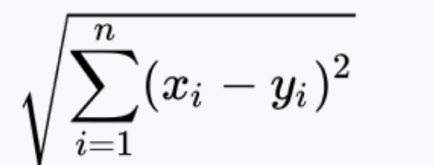
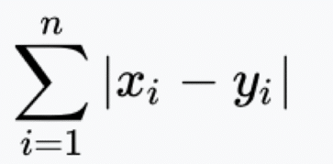
K-nearest Neighbor (KNN)
A non-parametric algorithm that classifies or predicts a data point based on the majority class (or average value) of its k-nearest neighbors.
Working:
Choose the number of neighbors (‘k’).
Calculate distances between the data point and all other points.
Identify the k-nearest neighbors. Shortest distance, majority or rank
For classification: Assign the majority class.
For regression: Compute the average of neighbors.
Distance Matrices
Euclidean
Manhattan

Slide 14
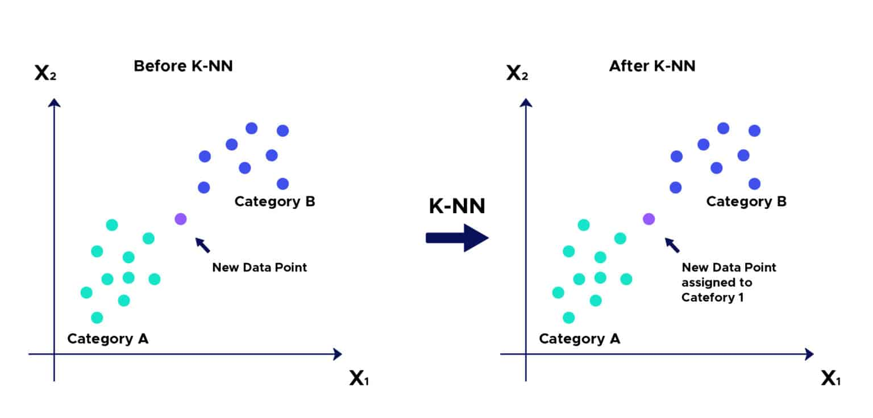

Slide 15
KNN numerical example
Explain KNN algorithm with an appropriate example.

Slide 16
Naïve bayes
Naive Bayes is a simple and effective classification algorithm.
Based on Bayes’ Theorem with the assumption of feature independence.
Works well with high-dimensional data.
Bayes’ Theorem Refresher
Formula: P(A|B) = [P(B|A) * P(A)] / P(B) → already studied
A = Class, B = Data/Features
Predicts class probabilities given feature values.
Types of Naive Bayes Classifiers
Gaussian Naive Bayes: For continuous data (assumes normal distribution).
Multinomial Naive Bayes: For discrete counts (e.g., word counts in text).
Bernoulli Naive Bayes: For binary/boolean features.

Slide 17
Logistic Regression

Slide 18
Support Vector Machines
Statistical learning theory, developed in the 1990s- SVM is a supervised learning algorithm used for classification and regression, whose main idea is Find a hyperplane that best separates the data into classes,
How it works:
SVM finds the optimal hyperplane with the maximum margin between classes.
Support vectors are data points closest to the hyperplane.
A larger margin = better generalization.
FOR CLASSIFICATION | FOR REGRESSION
Binary classification: two classes | Used for continuous output prediction
Multi-class classification: 1 v 1 or 1 v all | Tries to fit a line within threshold

Slide 19
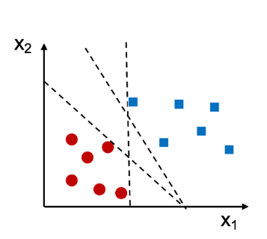

Slide 20
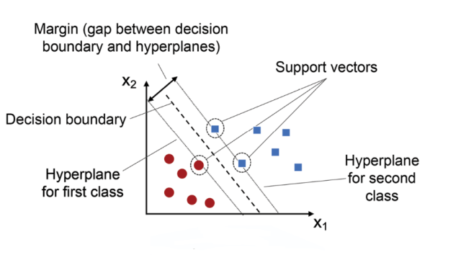

Slide 21
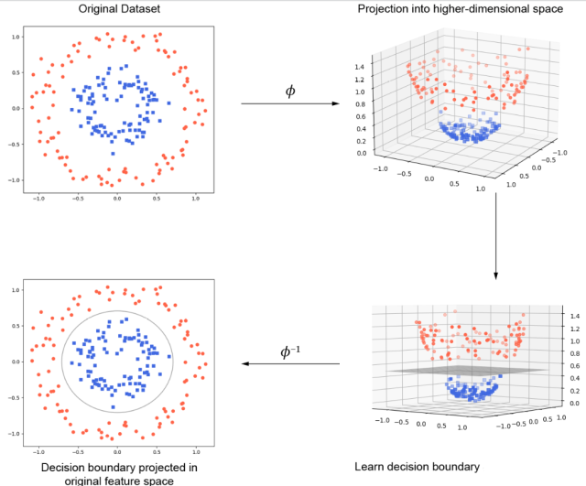

Slide 22
Pros, Cons and Applications of SVM
Advantages
Effective in high-dimensional spaces.
Works well for both linear and non-linear data.
Memory efficient.
Applications
Text categorization
Handwriting recognition
Bioinformatics (e.g., cancer classification)
Stock market prediction
Limitations
Not suitable for large datasets (slow training time).
Choosing the right kernel and parameters is tricky.
Poor performance with noisy and overlapping classes.

Slide 23
Applications of Supervised Learning
Prediction of stock markets (Price → trend)
Speech and Image Recognition
Object detection (Image/Object → Label)
Email spam detection (Spam / Not Spam
Handwriting recognition (Image → Letter)
Weather prediction (Temperature, Humidity → Rain/No Rain)
House price prediction (Features → Price)
Customer Sentiment Analysis
Medical Diagnosis

Slide 24
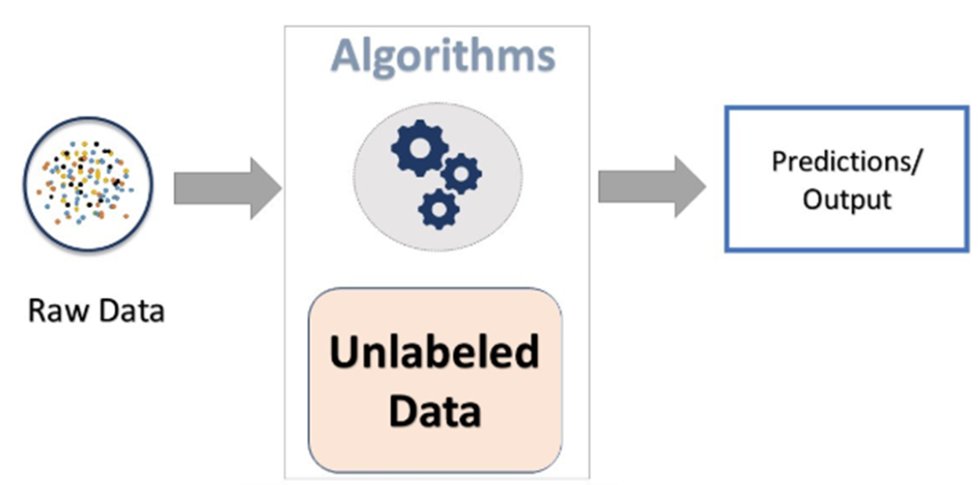
Unsupervised Learning
Learning from unlabeled data, identifying patterns and structures.
Applications:
Customer Segmentation
Fraud Detection
Dimensionality Reduction

Slide 25
Types of Unsupervised learning
Clustering:
Grouping customers by purchasing behavior.
K-Means, Hierarchical Clustering.
Dimensionality Reduction:
Reducing the number of features in a dataset.
PCA, .
Association:
Reducing the number of features in a dataset.
PCA, .

Slide 26
Clustering
An unsupervised learning task that groups data points into clusters based on similarity.
Types of Clustering:
Centroid-based: K-means
Density-based: DBSCAN
Hierarchical: Agglomerative Clustering
Applications:
Customer segmentation
Document categorization

Slide 27
K Means Clustering
A centroid-based clustering algorithm that divides data into k clusters by minimizing within-cluster variance.
Algorithm Steps:
Choose the number of clusters (‘k’).
Initialize ‘k’ centroids randomly.
Assign each data point to the nearest centroid.
Update centroids by computing the mean of assigned points.
Repeat steps 3 and 4 until convergence.
Use Cases:
Market segmentation
Image compression

Slide 28
Numerical on k-means clustering
Write down algorithm for K means clustering. Explain with suitable example.
Using k means clustering, cluster the following data into two clusters and show each step: {2,4,10,12,3, 20, 30, 11, 25}.

Slide 29
Dimensionality Reduction
Process of reducing the number of input variables in a dataset. Used in handling high-dimensional data (curse of dimensionality). Enhances model performance and visualization.
Why Dimensionality Reduction?
Reduces computation time.
Helps avoid overfitting.
Removes noise and redundancy.
Enables data visualization in 2D/3D.
Applications of Dimensionality Reduction
Image and speech recognition.
Bioinformatics (e.g., gene expression data).
Text data analysis (e.g., topic modeling).
Preprocessing step in machine learning pipelines

Slide 30
PCA
Unsupervised linear technique.
Projects data onto directions of maximum variance.
New axes are called principal components.
Used for compression and visualization.
Notes:
It is an unsupervised dimensionality reduction technique that transforms a large set of possibly correlated variables into a smaller set of uncorrelated variables called principal components. I tetains most of the original data's variance and information, making datasets easier to visualize, analyze, and process faster by removing redundancy and noise.
It works by finding new axes (components) that capture the maximum spread (variance) in the data, effectively compressing high-dimensional data into a lower-dimensional space.
How PCA Works (High-Level)
1. Standardize Data: Scale features so they contribute equally.
2. Covariance Matrix: Calculate the covariance matrix to understand feature relationships.
3. Eigenvectors & Eigenvalues : Find the eigenvectors (directions) and eigenvalues (importance/variance) from the covariance matrix/
4. Select Components: Choose the top components (eigenvectors) with the highest eigenvalues that explain most of the variance.
5. Transform Data: Project the original data onto these new, fewer components
Key Uses in Machine Learning
Dimensionality Reduction: Reduces the number of features, speeding up training and preventing the curse of dimensionality.
Data Visualization: Projects high-dimensional data (e.g., 100 features) into 2D or 3D for visual inspection of patterns, clusters, and correlations.
Feature Extraction: Creates new, more informative, uncorrelated features (principal components).
Noise Reduction: Filters out less important dimensions that might contain noise, improving model performance.
Overfitting Prevention: By reducing features, it can help models generalize better to new data
Pros: Faster computation, easier visualization, less overfitting, noise reduction, multicollinearity mitigation.
Cons: Information loss, sensitivity to outliers, reduced interpretability (components are abstract combinations), assumes linearity, requires data scaling
Common Applications
Image Processing (compression, face recognition)
Finance & Economics
Text Mining & NLP
Genetics & Biology

Slide 31
Linear Discriminant Analysis
Supervised method.
Maximizes class separability.
Finds linear combinations of features that best separate classes.

Slide 32
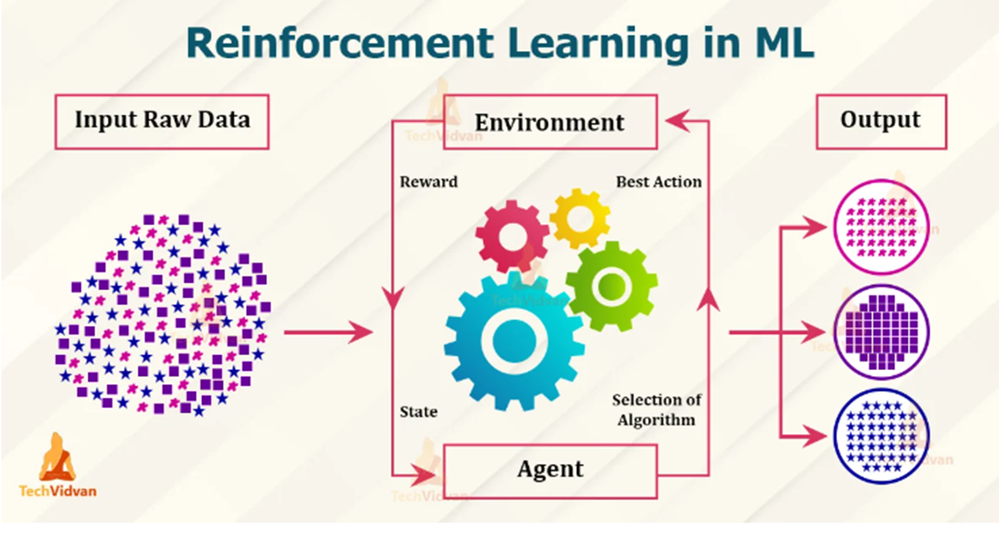
Reinforcement Learning
Learning by interacting with an environment to maximize cumulative rewards.
Key Characteristics:
Involves agents, actions, states, and rewards.
Goal: Learn a policy for optimal decision-making.
Applications:
Game Playing (e.g., Chess, Go)
Autonomous Vehicles
Robotics

Slide 33
Types of Reinforcement Learning
1. Positive Reinforcement:
Reward for correct actions.
Example: Training a robot to walk.
2. Negative Reinforcement:
Penalty for incorrect actions.
Example: Learning to avoid obstacles in a maze.

Slide 34
Comparison
Feature | Supervised Learning | Unsupervised Learning | Reinforcement Learning
Data Type | Labeled | Unlabeled | Interactive
Goal | Predict output | Find patterns | Maximize rewards
Applications | Image recognition, Spam | Customer segmentation | Game playing, Robotics
Algorithms Examples | SVM, Decision Trees | K-Means, PCA | Q-Learning, Deep Q-Networks

Slide 35
Boltzmann Machines
It is unsupervised Deep Learning model, Invented by Geoffrey Hinton and Terry Sejnowski (1985). A type of stochastic recurrent neural network. Inspired by statistical mechanics.
Key Concepts
Composed of visible and hidden units.
Units are binary-valued and symmetrically connected.
Learning involves adjusting weights to minimize energy.
Two types of nodes:
Visible nodes — those nodes which we can and do measure
Hidden nodes - those nodes which we cannot or do not measure.
The training data is fed into the Boltzmann Machine and the weights of the system are adjusted accordingly. Boltzmann machines help us understand abnormalities by learning about the working of the system in normal conditions.

Slide 36
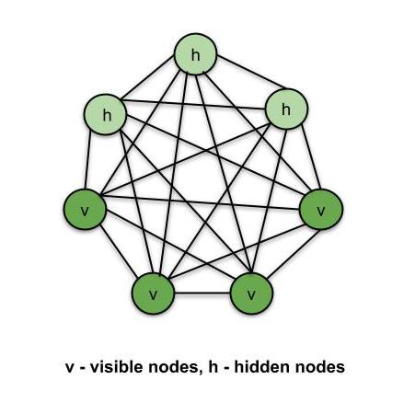
A Hopfield net that consists of Binary Stochastic Neuron with hidden units is Boltzmann machine.
These connected neurons make stochastic decisions about whether being on or off.

Slide 37
Deep Learning
A subset of machine learning using neural networks with many layers. Learns hierarchical representations from data. Enables breakthroughs in image, speech, and language processing.
Deep Neural Networks (DNNs)
Neural networks with multiple hidden layers.
Greater depth = more abstract features.
Require large datasets and computational power.
Key Architectures
Convolutional Neural Networks (CNNs): Used for image data.
Recurrent Neural Networks (RNNs): Used for sequential data.
Generative Adversarial Networks (GANs): two networks—a generator and a discriminator—that compete to create realistic data ( image generation)
Transformers: Modern architecture for NLP and more. Used in chat gpt and others
Notes:
Types of neural networks
Feedforward neural networks (FNNs) are the simplest type of ANN, where data flows in one direction from input to output. It is used for basic tasks like classification.
Convolutional Neural Networks (CNNs) are specialized for processing grid-like data, such as images. CNNs use convolutional layers to detect spatial hierarchies, making them ideal for computer vision tasks.
Recurrent Neural Networks (RNNs) are able to process sequential data, such as time series and natural language. RNNs have loops to retain information over time, enabling applications like language modeling and speech recognition. Variants like LSTMs and GRUs address vanishing gradient issues.
Generative Adversarial Networks (GANs) consist of two networks—a generator and a discriminator—that compete to create realistic data. GANs are widely used for image generation, style transfer and data augmentation.
Autoencoders are unsupervised networks that learn efficient data encodings. They compress input data into a latent representation and reconstruct it, useful for dimensionality reduction and anomaly detection.
Transformer Networks has revolutionized NLP with self-attention mechanisms. Transformers excel at tasks like translation, text generation and sentiment analysis, powering models like GPT and BERT.

Slide 38
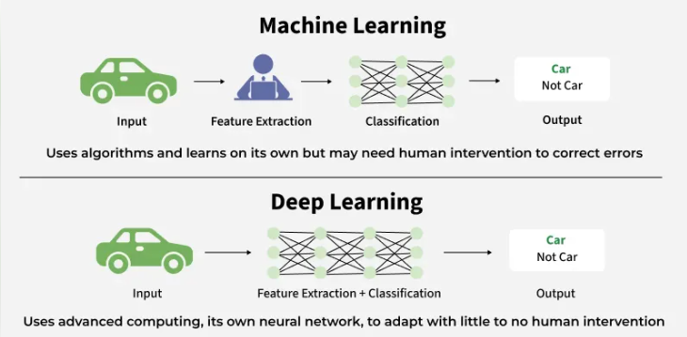
ML vs DL

Slide 39
Application, Challenges and Recent Advancements
Applications of Deep Learning
Computer vision (object detection, facial recognition)
Natural language processing (translation, summarization)
Speech recognition
Medical diagnosis
Recent Advancements
GPT models for language generation.
AlphaFold for protein folding.
Generative Adversarial Networks (GANs).
Self-supervised and foundation models.
Challenges in Deep Learning
Requires large labeled datasets.
Prone to overfitting.
High computational cost.
Interpretability of models.

Slide 40
Artificial Neural Network (ANN)
ANN is a computational model inspired by the human brain, consisting of interconnected processing units called neurons.
ANNs are used to learn patterns, recognize data, and make decisions from examples rather than explicit programming.
Applications:
Image recognition
speech recognition
medical diagnosis
recommendation systems
fraud detection etc

Slide 41
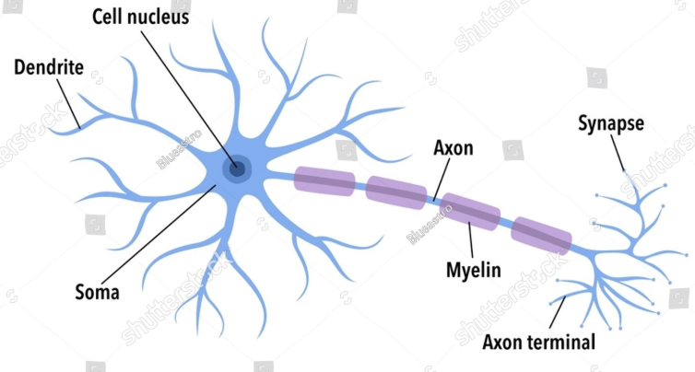
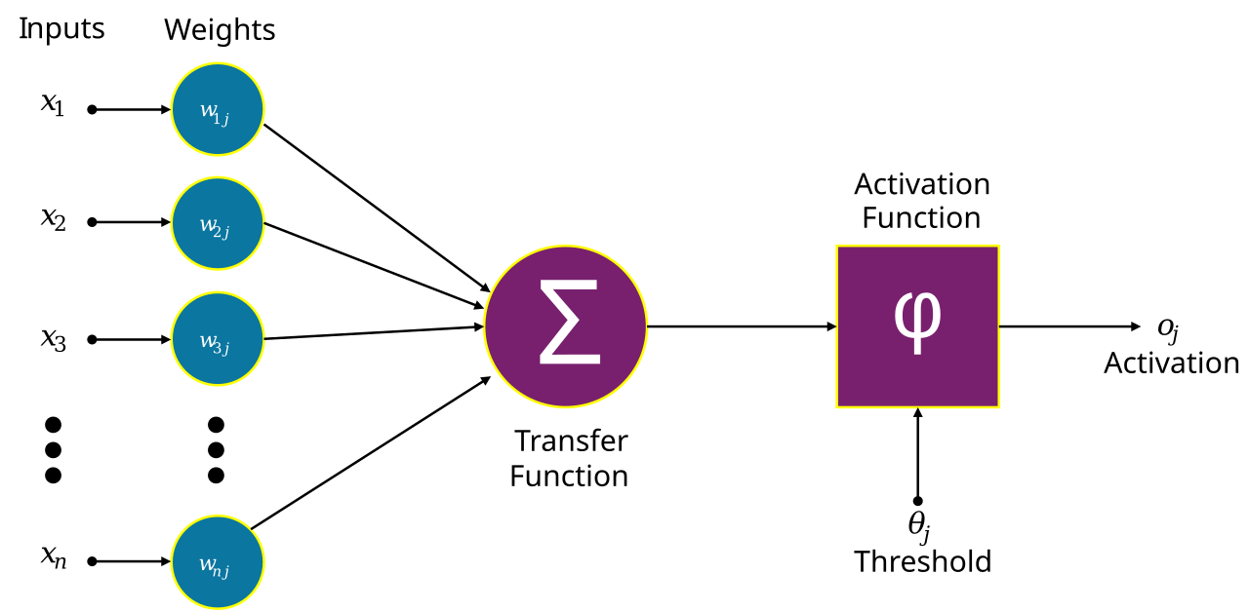
Biological Inspiration
Inputs
Weights and Summation
Biological neuron receives signals through dendrites
Processes signals in the cell body
Sends output through the axon
Activation Function
Output
Notes:
The human brain is the core inspiration for artificial neural networks (ANNs).
The brain is made up of billions of neurons that communicate through synapses.
A neuron receives inputs, processes them, and sends signals to other neurons, allowing complex behaviors and learning.
ANNs mimic this biological process by creating interconnected artificial neurons that process information similarly.
ANN mimics how the brain learns from experience by strengthening or weakening connections.

Slide 42
Basic Components of ANN
Neurons: Basic Processing Units, Performs weighted sum of inputs
Weights: Represents strength of connections, Adjusted later during training
Biases: Helps shift activation Functions,, Improves learning flexibility
Activation Function: Determines neurons output, Introduces non-linearity
eg: Sigmoid, Tenh, ReLU, SoftMax
Various Layers:
Input Layer: Receives the input data.
Hidden Layers: Process inputs by applying mathematical operations to learn complex patterns.
Output Layer: Provides the final result, such as classification or prediction.

Slide 43
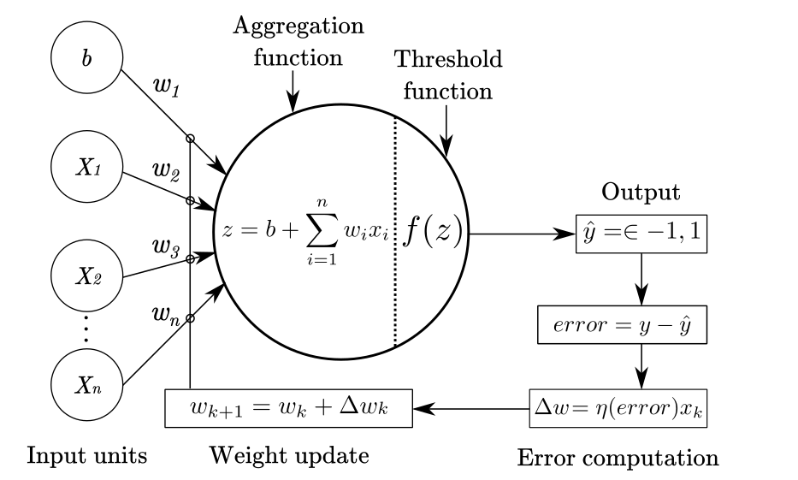
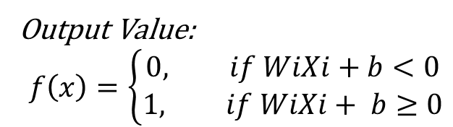
Single-Layer Perceptron
The simplest type of neural network with one input and one output layer.
Applies a linear activation function to input data.
Solves only linearly separable problems.
Output Value:
$$f\left(x\right)=\left\{\begin{aligned}0, if WiXi+b<0 \\ &1, if WiXi+ b≥0\end{aligned}\right.$$

Slide 44
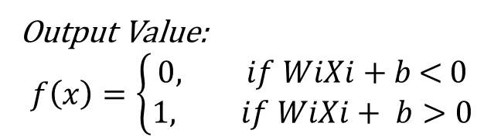
Logic Gate Concept
Predication (Y) ≤
Output Value:
$$f\left(x\right)=\left\{\begin{aligned}0, if WiXi+b\text{ < }0 \\ &1, if WiXi+ b>0\end{aligned}\right.$$

Slide 45
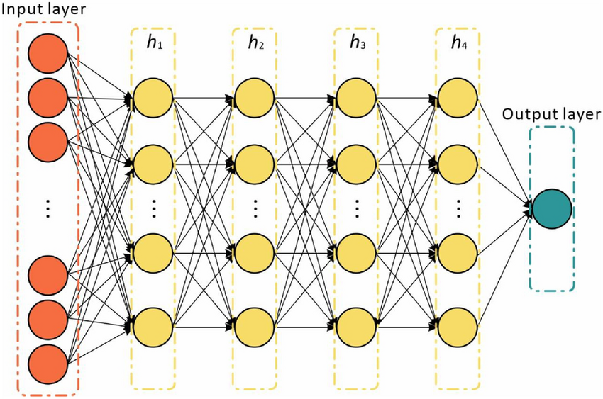
Multi-Layer Perceptron (MLP)
An advanced network with multiple layers: input, hidden, and output.
Uses activation functions like ReLU or Sigmoid to introduce non-linearity.
Can solve complex, non-linearly separable problems.
Widely used in applications like image recognition and natural language processing.

Slide 46
Training Neural Networks
Training is the process of adjusting weights and bias so the network produces correct output.
Steps in Training:
Initialize weights randomly
Forward propagation : Input is passed through the network
Calculate error (loss)
Difference between actual and predicted output
Backpropagation: Error is propagated backward
Weight update
Weights updated using optimization methods (e.g., Gradient Descent)
Repeat until error is minimized
Notes:
Training a neural network involves modifying weights using error feedback to minimize prediction error.
Forward propagation makes predictions, and loss is calculated to measure errors.
Backward propagation adjusts weights based on errors to improve accuracy.

Slide 47

Forward Propagation
Input data passes through the network to get an output.
Each neuron applies a mathematical function to the inputs, multiplies by weights, and adds a bias.
The result is passed through an activation function to introduce non-linearity.
The final output is used for prediction.
Steps:
Calculate the sum of Products:
S = b + $\sum_{i=1}^{n}{Xi ∗Wi}$
Activation Function:
F(s) = $\frac{1}{1+e^{−s}}$

Slide 48
Backward Propagation
Error is propagated backward through the network.
The gradient of the loss function with respect to each weight is calculated.
Weights are updated in the opposite direction to reduce the loss.
This process is repeated to improve accuracy.

Slide 49
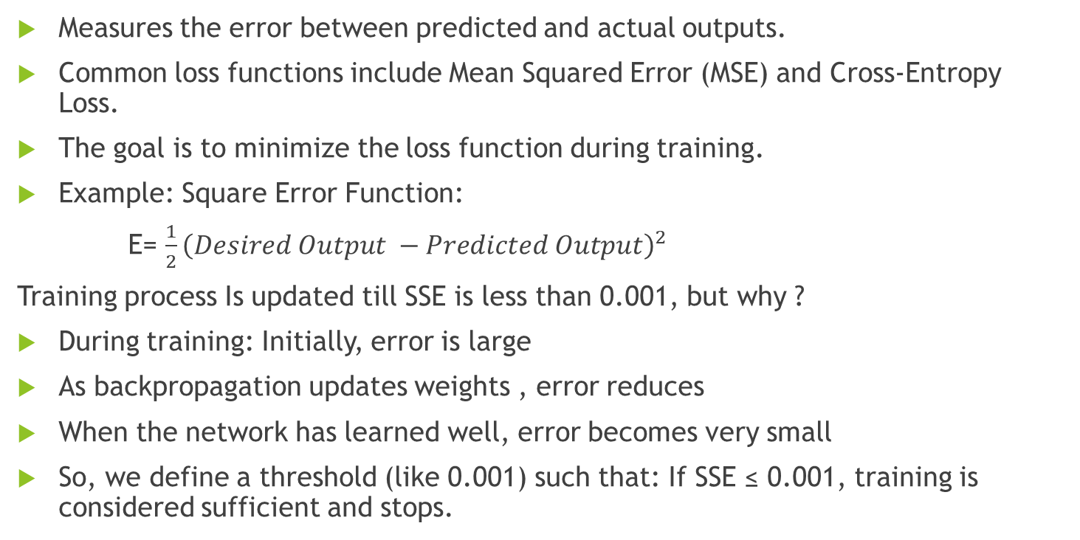
Loss Function
Measures the error between predicted and actual outputs.
Common loss functions include Mean Squared Error (MSE) and Cross-Entropy Loss.
The goal is to minimize the loss function during training.
Example: Square Error Function:
E= $\frac{1}{2}{\left(Desired Output −Predicted Output\right)}^{2}$
Training process Is updated till SSE is less than 0.001, but why ?
During training: Initially, error is large
As backpropagation updates weights , error reduces
When the network has learned well, error becomes very small
So, we define a threshold (like 0.001) such that: If SSE ≤ 0.001, training is considered sufficient and stops.

Slide 50
Learning Rate (α) or Eta (η)
Controls how much the network's weights are updated during training.
Too high:
Can cause instability by overshooting optimal weights i.e. system will not converge
Too low:
Can slow down convergence or get stuck in a local minimum.
Choosing the right learning rate is crucial for effective training.
Typically, it is selected by trial and error
Range: 0.01 < α < 1.0

Slide 51
Numerical Example:
For single perceptron
For multilayer perceptron
Logic gate

Slide 52
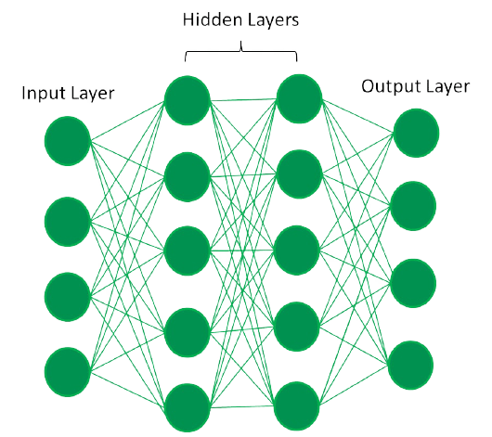
3blue1brown for more visual

Slide 53
Summary
ANNs are inspired by the human brain.
Components include input, hidden, and output layers, weights, and biases.
Training involves forward propagation, loss calculation, and backward propagation.
Learning rate affects the speed and accuracy of training.
Single-layer perceptrons solve simple problems, while multi-layer perceptrons handle complex tasks.

Slide 54
Questions & Discussion
Let's discuss ANN concepts further!

